Slide 1

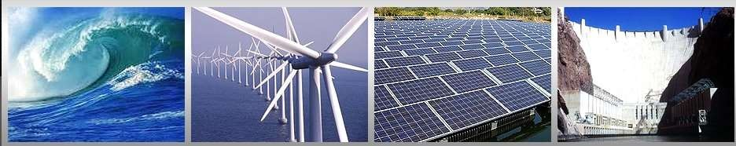
Management Topic in Environmental Studies)
B. Tech 7TH Semester
Energy resources
Unit 2
Natural Resources
Department: Chemistry
Subject: MTES (CHM 2049)

Slide 2
Contents
Introduction to Energy resources
Growing Energy Demands
Renewable and Non Renewable Energy
Solar Energy
Wind energy, Hydropower
Tidal energy
Geothermal and Biomass Energy
Coal, Petrol, Natural gas, Nuclear power

Slide 3
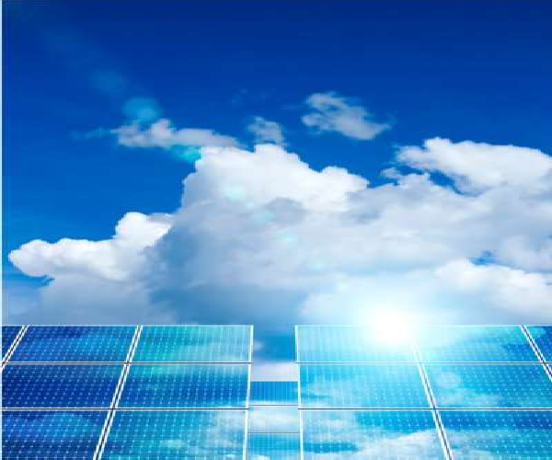
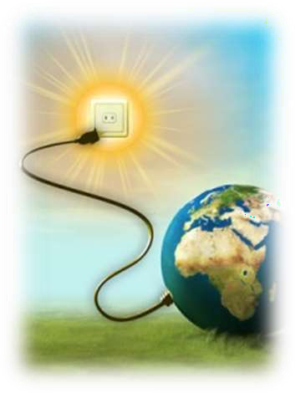
Energy Resources
Energy may be defined as the capacity to do work.
Both energy production and energy utilization are the indicators of a country’s progress as it is a primary input for industrial operation.

Slide 4

Growing energy needs
Energy is an important input for development.
It aims at human welfare covering household ,agricultural transport and industrial complexes.
Due to the population explosion the demand for various forms of energy has got increased many folds.
U.S.A. and Canada constitute about 5% of the world's population but consume one fourth of global energy resources.
An average person there consumes 300 GJ (Giga Joules, equal to 60 barrels of oils) per year. By contrast, an average man in a poor country like Bhutan, Nepal or Ethiopia consumes less than 1 GJ in a year.

Slide 5

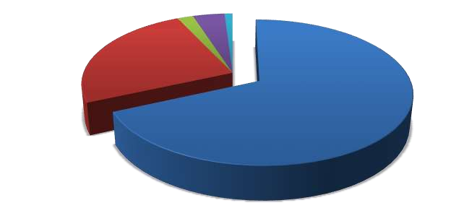
Types of energy consumed
Diesel and Gas 4%
Other 1%
Nuclear power 2%
Hydral power
25%
Thermal power 68%

Slide 6

Energy demand
Indian population is still heavily depend on traditional fuel such as firewood, animal waste and agricultural residue.
But the share of commercial energy on the total energy demand has been increasing vastly.
Energy consumption (In India, 1990-1991)
Sector | Percentage | Coal | Oil/Natural | Electricity
Industry | 51.00 | 69.96 | 13.10 | 17.30
Transport | 23.30 | 9.60 | 88.90 | 1.50
Household | 13.80 | 3.90 | 77.10 | 19.00
Agriculture | 9.60 | - | 57.10 | 42.90
Others | 2.30 | - | 29.20 | 70.80

Slide 7
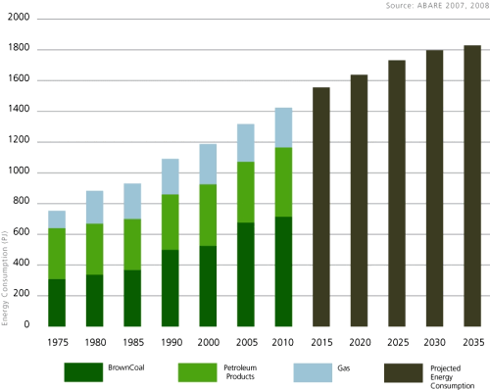
Growing energy needs

Slide 8


Primary Energy Resources
Renewable/Inexhaustible/Non-Conventional sources of energy.
Example : Wood, Solar energy etc
Secondary Energy Resources
Does occur in nature but are derived from primary energy sources
Example: Petrol, Hydrogen obtained through electrolysis of water etc.

Slide 9
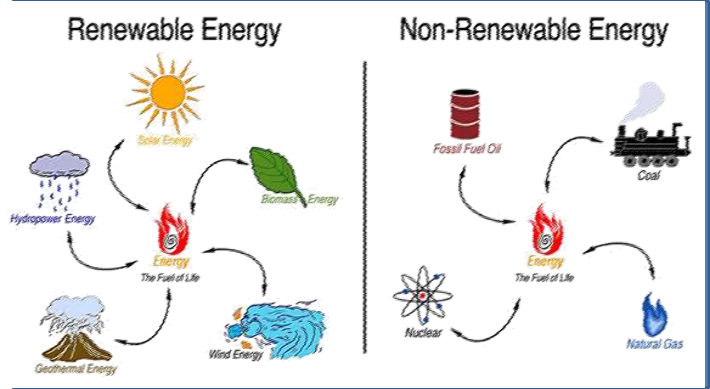
Types of Energy
Alternative energy
Energy can not regenerate it exhaustible
Renewable resource is a natural resource with the ability to reproduce through biological or natural processes and replenished with the passage of time and are inexhaustible

Slide 10
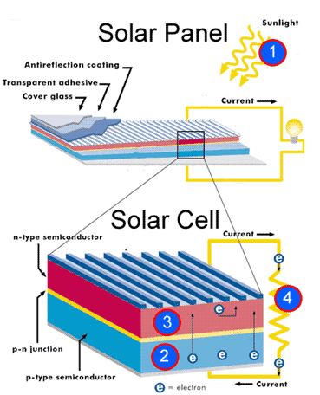
Solar cells (or) photovoltaic cells (or) PV cells
Solar cells consist of a p-type semiconductor (such as Si doped with B) and n-type semi-conductor (Si doped with P).
When the solar rays fall on the top layer of p-type semi-conductor, the electrons from the valence band get promoted to the conduction band and cross the p-n junction into n-type semi-conductor.
There by potential difference between two layers is created, which causes flow of electrons (ie.,an electric current)
Solar cell Uses
Used in calculators, electronic watches. Street lights, water pumps to run radios and TVs.
Solar Battery
When a large number of solar cells are connected in series it form a solar battery.
Solar battery produce more electricity which is enough to run water pump, to run street-light, etc.,
They are used in remote areas where conventional electricity supply is a problem.

Slide 11
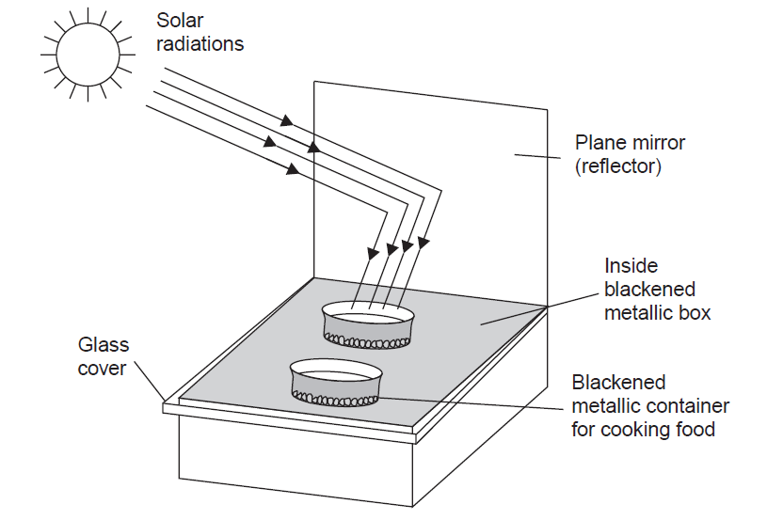

Solar Energy
Solar cooker: Solar cookers make use of solar heat by reflecting the solar radiations using a mirror directly on to a glass sheet which covers the black insulated box within which the raw food is kept
Convex or parabolic reflector
Solar water heater: It consists of an insulated box painted black from inside and having a glass lid to receive and store solar heat.
Inside the box it has black painted copper coil through which cold water is made to flow in, which gets heated and flows out into a storage tank.
Solar furnace: Here thousands of small plane mirrors are arranged in convex reflectors, all of which collect the solar heat and
produce as high a temperature as 3000°C.
vi) Solar power plant: Solar energy is harnessed on a large scale by using convex reflectors which cause boiling of water to produce steam. The steam turbine drives a generator to produce electricity. A solar power plant (50 K Watt capacity) has been installed at Gurgaon,
Haryana.

Slide 12
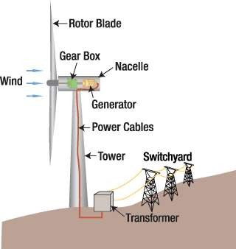
Wind energy
Rotor blades - capture wind's energy and convert it to rotational energy of shaft
Shaft - transfers rotational energy into generator
Nacelle - casing that holds the gear box
the gearbox includes the
generator which uses rotational energy of shaft to generate electricity.
Brakes- stop rotation of shaft in case of
power overload or system failure.
Tower - supports rotor and nacelle and lifts entire setup to higher elevation where blades can safely clear the ground
Electrical equipment - carries electricity from generator down through tower and controls many safety elements of turbine.
The minimum wind speed required is 15 km/h
The wind power potential of India is estimated to be about 20,000 MW, while at present we are generating about 1020 MW.

Slide 13
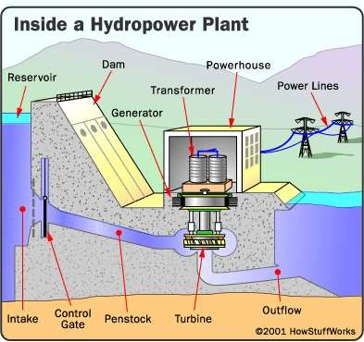
Hydro power
An intake: to diverts of the flow
from the water course.
penstock pipe to convey the water to the turbine.
Powerhouse: in which the turbine and generator convert the water's energy into electricity.
Outflow: through which the water is released back to the river or stream.
Underground cables or overhead lines: to transmit the electricity to it's point of use. These must be short enough to minimize ‘voltage drop.’
The hydropower potential of India is estimated to be about 4 × 1011 KW-hours.

Slide 14
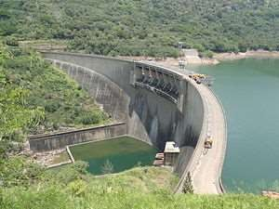
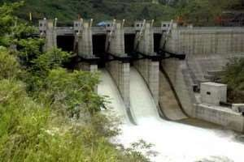
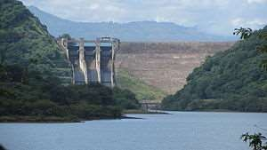
The Victoria Dam
The Upper Kotmale Hydro Power Plant

Slide 15
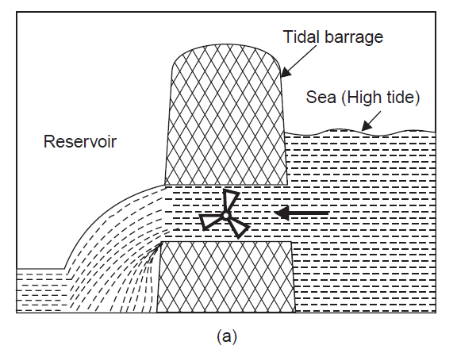
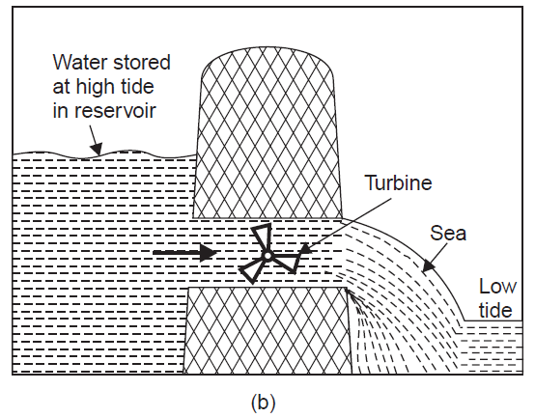
Tidal Energy
A difference of several meters is required between the height of high and low tide to spin the turbines.
The tidal energy can be harnessed by constructing a tidal barrage.
(A)
(B)
(A) During high tide, the sea-water flows into the reservoir of the barrage and turns the turbine, which in turn produces electricity by rotating the generators.
(B)During low tide, when the sea-level is low, the sea water stored in the barrage reservoir flows out into the sea and again turns the turbines

Slide 16
Tidal Energy
The bay of Fundy Canada having 17-18 m high tides has a potential of 5,000 MW of power generation.
In India Gulf of Cambay, Gulf of Kutch and the Sunder bans deltas are the tidal power sites.

Slide 17
Ocean thermal energy
The energy available due to the difference in temperature of water at the surface of the tropical oceans and at deeper levels is called Ocean Thermal Energy. Minimum difference of 20°C needed
The warm surface water of ocean is used to boil a liquid like ammonia.
The high pressure NH₃ vapours of the liquid formed by boiling are then used to turn the turbine of a generator and produce electricity.
The colder water from the deeper oceans is pumped to cool and condense the vapours into liquid.
Thus, the process keeps on going in cycle continuously for 24 hours a day.

Slide 18
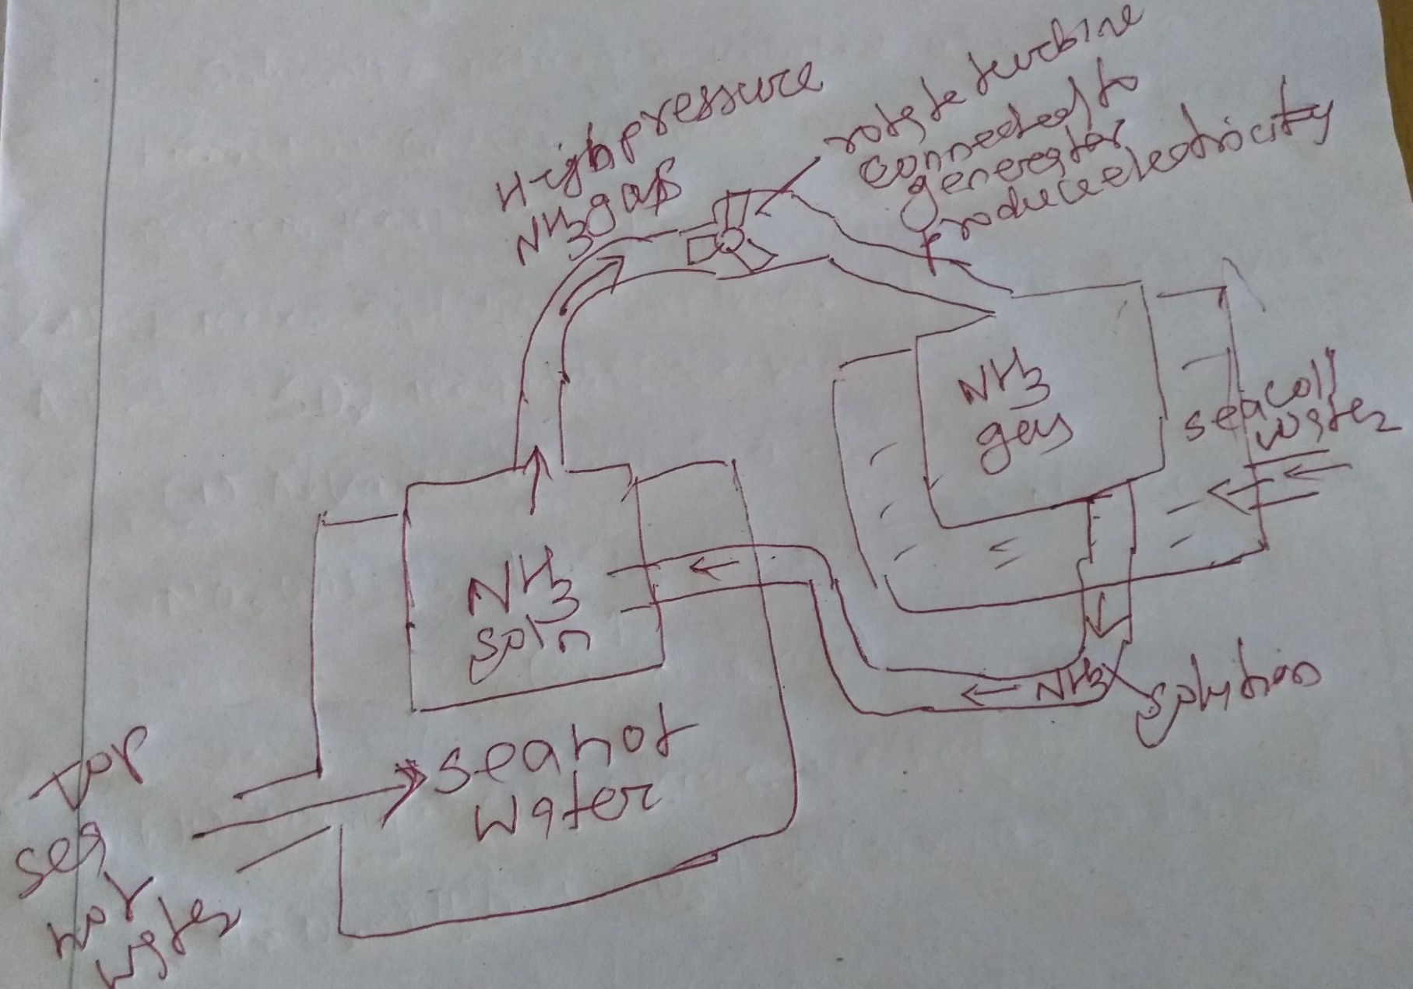
Ocean thermal energy

Slide 19
Geothermal energy
Geothermal energy: The energy harnessed from the hot rocks present inside the earth is called geothermal energy.
High temperature, high pressure steam fields exist below the earth's surface in many places may be due to fission of radioactive material naturally present in the rocks.
In some places, the steam or the hot water comes out of the ground naturally through cracks in the form of natural geysers as in Manikaran, Kullu and Sohana, Haryana.
Artificially drill a hole up to the hot rocks and by putting a pipe in it make the steam or hot water gush out through the pipe at high pressure which turns the turbine of a generator to produce electricity.
In USA and New Zealand, there are several geothermal plants working successfully.

Slide 20
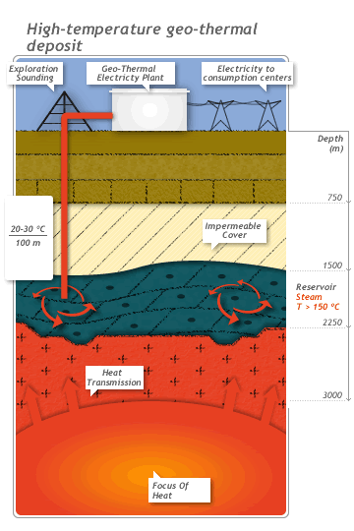
Geo-thermal Energy
Temperature of the earth increases at a rate of 20-75⁰C per km, when we move down the earth surface.
High temperature and high pressure steam fields
exists below the earth’s surface in many places.
The energy harnessed from the high temperature
present inside the earth is called geothermal energy.
Natural geysers
In some places, the hot water (or) steam comes out
of the ground through cracks naturally in the form
Artificial geysers
In some places, we can artificially drill a hole up to
the hot region and by sending a pipe in it, we can
make the hot water or steam to rush out through
the pipe with very high pressure.
Thus, the hot water (or) steam coming out from the
natural (or) artificial geysers is allowed to rotate the
turbine of a generator to produce electricity.

Slide 21
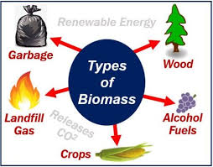
Biomass Energy
Biomass is the organic matter produced by the plants or animals which include wood, crop residues, cattle dung, manure, sewage, agricultural wastes etc.
Biomass energy Types
Energy Plantations:
Solar energy is trapped by green plants through photosynthesis and converted into biomass energy.
Fast growing trees like cottonwood, and Leucaena (Bada chakunda), non-woody crop plants like sugarcane, sweet sorghum and sugar beet, and carbohydrate rich potato, cereal etc. are some of the important energy plantations.
They may produce energy either by burning directly or converted into fuels by fermentation.

Slide 22
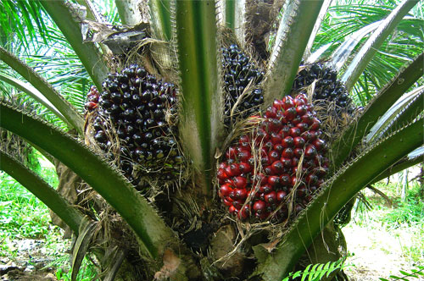


Petro-crops
(b) Petro-crops: Certain latex-containing plants like Euphorbias and oil palms are rich in hydrocarbons and can yield an oil like substance under high temperature and pressure.
This oily material may be burned in diesel engines directly or may be refined to form gasoline.
These plants are popularly known as petro-crops.
Gasoline:paraffins, naphthenes,
aromatics and olefins
oil palms
Jatropha
Euphorbias

Slide 23
Biomass Energy
(c) Agricultural and Urban Waste biomass: Crop residues, bagasse (sugarcane residues), coconut shells, peanut hulls, cotton stalks etc. produce energy by burning.
Animal dung, fishery and poultry waste and even human refuse are examples of biomass energy
In Brazil 30 % of electricity is obtained from burning bagasse.
In rural India, animal dung cakes burnt to produce heat.

Slide 24
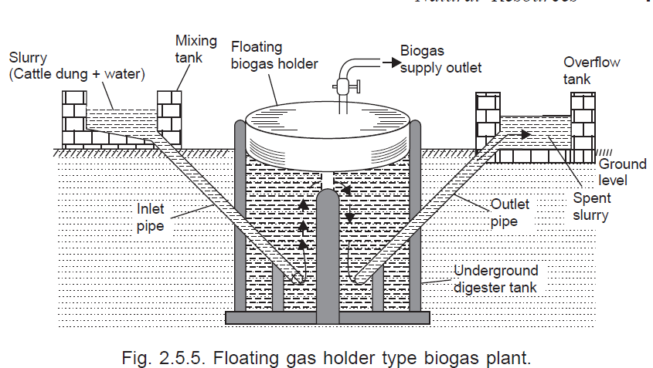
Biogas Energy
Biogas is produced by anaerobic degradation of animal wastes, food waste etc
Anaerobic treatment is a biological process carried out in the absence of O₂ for the stabilization of organic materials by conversion to CH₄ and inorganic end-products such as CO₂ and NH₃
Anaerobic microbes
With favorable Temp , pH
Organic materials + Nutrients/Mineral + CO₂ +NH₃ +H₂O+CH₄+H₂S+Biomass+ End product

Slide 25
Biofuels Energy
Biomass (sugarcane) can be fermented (Yeast) to alcohols like ethanol and methanol which can be used as fuels, as compared to petrol its calorific value is less
Gasohol (mixture of ethanol and gasoline) is a common fuel used in Brazil and Zimbabwe and start trial in India Kanpur.
Methanol too is a clean, non-polluting fuel. Methanol can be easily obtained from woody plants and ethanol
from grain-based or sugar-containing plants by fermention (Yeast)

Slide 26
Hydrogen Energy
Highest calorific value, hydrogen can serve as an excellent fuel. Moreover, it is non-polluting
(i) Thermal dissociation: of water (at 3000°K or above) hydrogen (H₂) is produced.
(iii) Electrolytic method: dissociates water into hydrogen (H₂) and oxygen by making a current flow through it.
(iv) Photocatalytic methods: of water involves breakdown of water in the presence of sun light to and semiconducter photocatalyst release hydrogen.
However, hydrogen is highly inflammable and explosive in nature. Hence, safe handling is required for using H₂ as a fuel. Also, it is difficult to store and transport.

Slide 27
Coal
Coal is the most abundant fossil fuel in the world.
Formation: The ancient plants along the banks of rivers and swamps were buried naturally or earth quake into the soil and due to the heat and pressure gradually got converted into peat and coal over millions of years of time.
Types
Anthracite (hard coal), bituminous (Soft coal) and lignite (brown coal).
Anthracite coal has maximum carbon (90%) and calorific value (8700 kcal/kg.)
Bituminous, lignite and peat contain 80, 70 and 60% carbon, respectively.
At the present rate of usage, the coal reserves are likely to last for another 65 years.
India has about 5% of world's coal

Slide 28
Petroleum
It is the lifeline of global economy. About 1/4thof the oil reserves are in Saudi Arabia.
At the present rate of usage, the world's crude oil reserves are estimated to get exhausted in just 40 years
Purified and refined by the process of fractional distillation, obtain petroleum gas, kerosene, petrol, diesel, fuel oil, lubricating oil, paraffin wax, asphalt, plastic etc.
Petroleum is a cleaner fuel as compared to coal as it burns completely and leaves no residue.

Slide 29
Liquefied Petroleum Gas
Liquefied petroleum gas (LPG): Butane, propane and ethane.
The petroleum gas is easily converted to liquid form under pressure as LPG.
Ethyl mercaptan, added to LPG to check leakage
Oil fields in India are located at Digboi (Assam), Gujarat Plains and Bombay High, offshore areas in deltaic coasts of Gadavari, Krishna, Kaveri and Mahanadi.

Slide 30
Natural gas
It is mainly composed of methane (95%) with small amounts of propane and ethane.
Natural gas deposits mostly accompany oil deposits because it has been formed by decomposing dead animals and plants buried under the earth.
Natural gas is the cleanest fossil fuel. transported through pipelines easily. It has a high calorific value of about 50KJ/gm and burns without any smoke.
World Reservoirs: Russia (40%), Iran (14%) and USA (7%).
India: Tripura, Jaisalmer, Off-shore area of Mumbai and the Krishna Godavari Delta.
It is used as a fuel in thermal power plants for generating electricity.
It is used as a source of hydrogen gas in fertilizer industry and as a source of carbon in tyre industry.

Slide 31
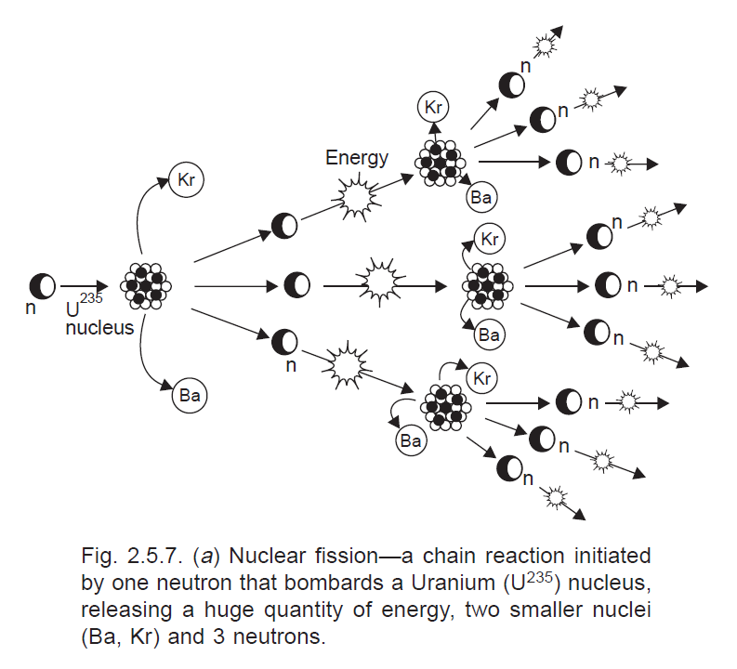
Nuclear energy
Nuclear Fission:
Nuclear energy is known for its high destructive power as evidenced from nuclear weapons.
Nuclear Fission: nucleus of certain isotopes with large mass numbers are split into lighter nuclei on bombardment by neutrons and a large amount of energy is released through a chain reaction as shown

Slide 32
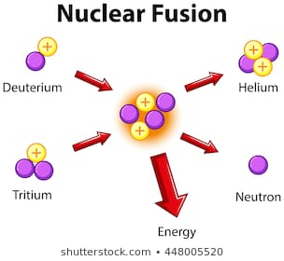
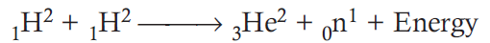
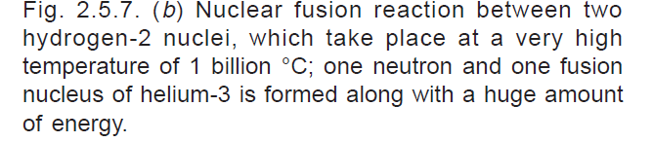
Nuclear fusion
(ii) Nuclear fusion: Here two isotopes of a light element are forced together at extremely high temperatures (1 billion °C) until they fuse to form a heavier nucleus releasing enormous energy in the process.
One neutron and a huge amount of energy.
E = MC²
1.674927471×10⁻²⁷ X (3X10⁸)²
It is difficult to initiate the process but it releases more energy than nuclear fission.
There are four nuclear power stations with an installed capacity of 2005 MW.
These are located at Tarapur (Maharashtra), Rana Pratap Sagar near Kota (Rajasthan), Kalpakkam (Tamil Nadu) and Narora (U.P.).

Slide 33
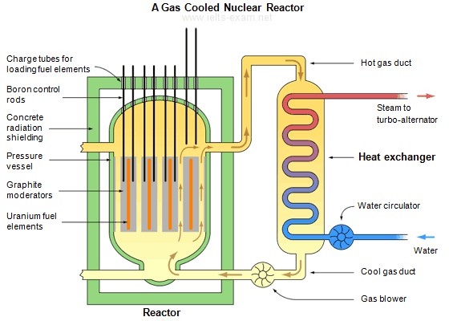
Nuclear reactor
If each neutron releases two more neutrons, then the number of fissions doubles each generation. In that case, in 10 generations there are 1,024 fissions and in 80 generations about 6 x 10 ²³ (a mole) fissions.
A nuclear reactor is a device in which nuclear chain reactions are initiated, controlled, and sustained at a steady rate,
Nuclear bomb, in which the chain reaction occurs in a fraction of a second and is uncontrolled causing an explosion.
Graphite: slow down the newtron and controller is to control the number of neutron
Boron: capable of absorbing many neutrons and control fission
Lead: molten lead or lead-bismuth eutectic coolant also absorb alfa, beta and gamma radiation

Slide 34
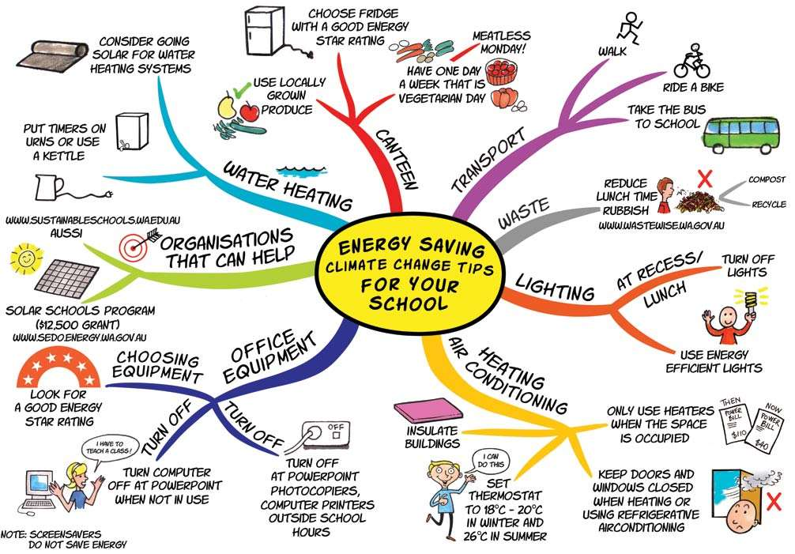

Slide 35


